Slide 1

Structural Integrity Assessment System
DEVELOPMENT PROJECT
Group 24
Milind Kurma
Luke Kim
Sharmisha Parvathaneni
Punit Malpani
This Photo by Unknown Author is licensed under CC BY-NC-ND

Slide 2
Project Overview
What is Structural Integrity Assessment System?
It is a system that proposes observation and analysis of the robustness and strength of a civil structure
It will monitor changes in mechanical and geometric properties of the structure using sensor technologies
Based on the sensor readings, appropriate analysis will make assessments & suggestion

Slide 3
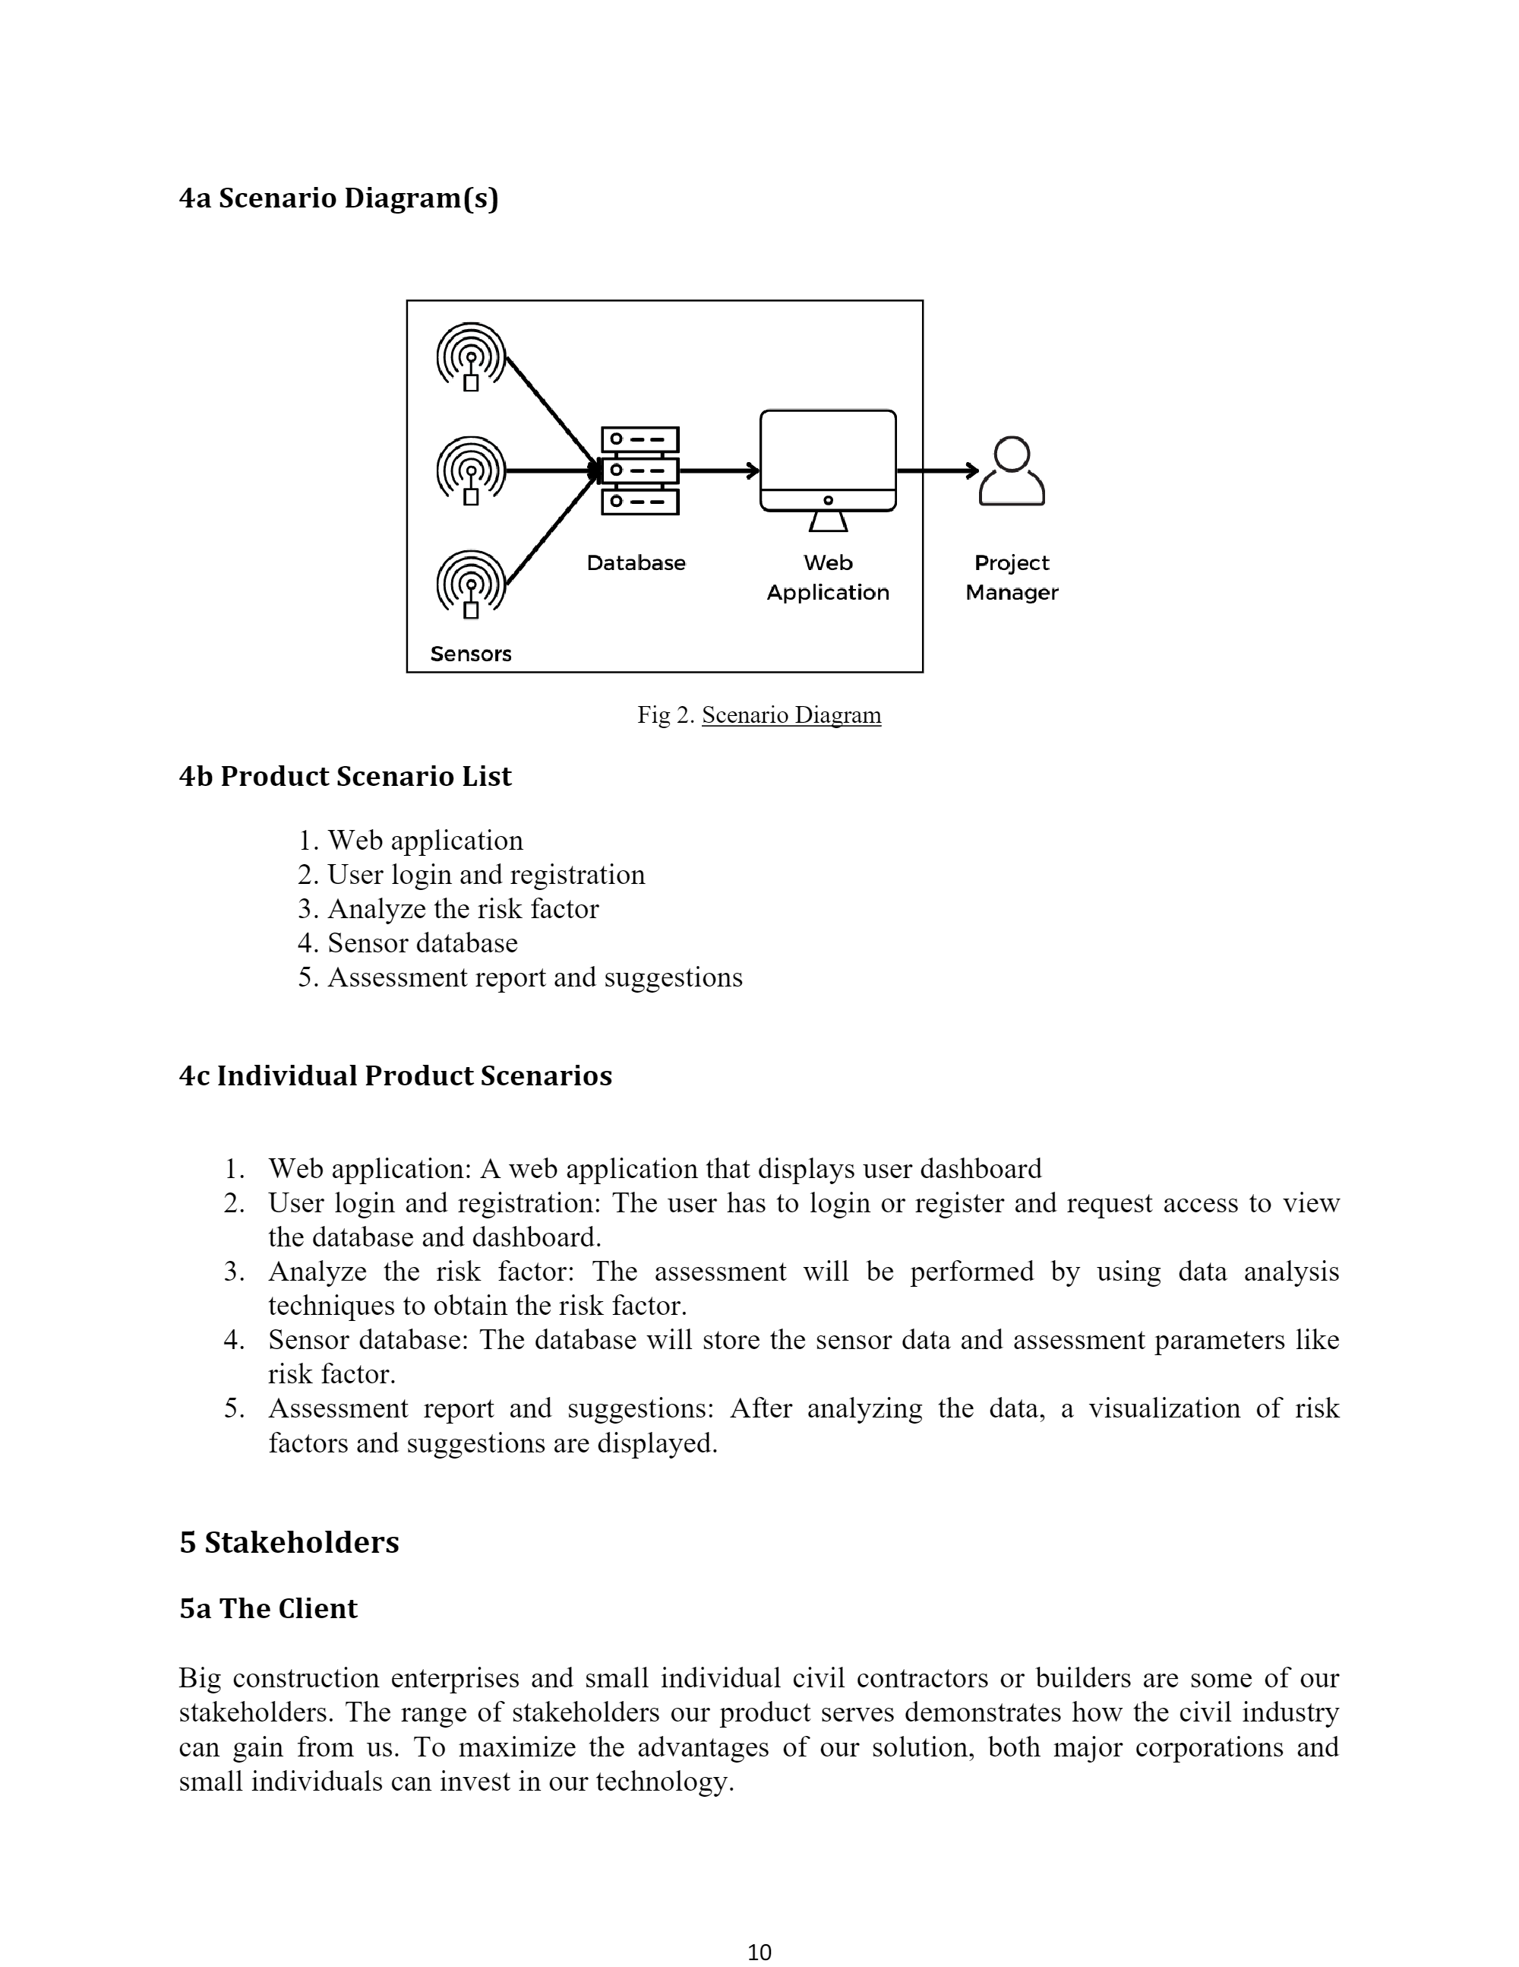
Goals of the Project
To make it easier for the user to evaluate civil structures
(As a structure’s size increases, strength assessment becomes complex)
A software application (web and mobile) rendering graphical data for parameters like tilt, crack, strain, will aid the construction engineers examine a structure’s strength.

Slide 4
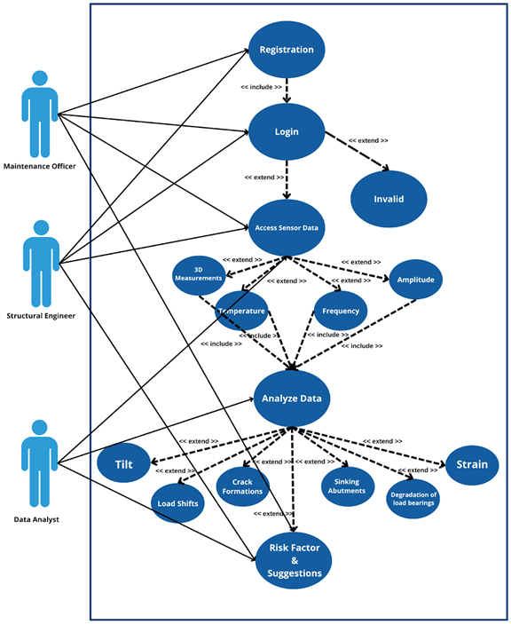
Use Case diagram

Slide 5
Functional Requirements
User Account setup and Login
Sensor Data Acquisition
Data Analysis
The system should perform analysis and calculations on the acquired sensor data relevant to tilts, cracks, strain in a structure
Output Risk factor and Suggestions
The system should display calculated risk factor and suggestions in form of a step-by-step guide comprising of actions to be taken

Slide 6
Data Requirements
System must store user account data
Data including Login information, number of buildings , structure types should be stored into cloud storage
System must collects distinct sensor data
Includes data such as tilts, cracks, strains, vibration
System must refine & process sensor data
System should perform Fourier frequency calculations to analyse

Slide 7
Performance Requirements
Risk analysis must be real-time
(Speed and Latency Requirement)
Sensor data deviation from actual must be within ± 1%
(Precision and Accuracy Requirement)
The system must be a 24/7 (except system maintenance)
(Capacity Requirement)
It should be cloud based so that the capacity of service is not limited.

Slide 8
Security Requirements
Application allows only selected users to view data results
(Access requirement)
System should preserve user and analysis data through data analysis
(Integrity requirement)
System must protect personal data
(Privacy requirement)

Slide 9
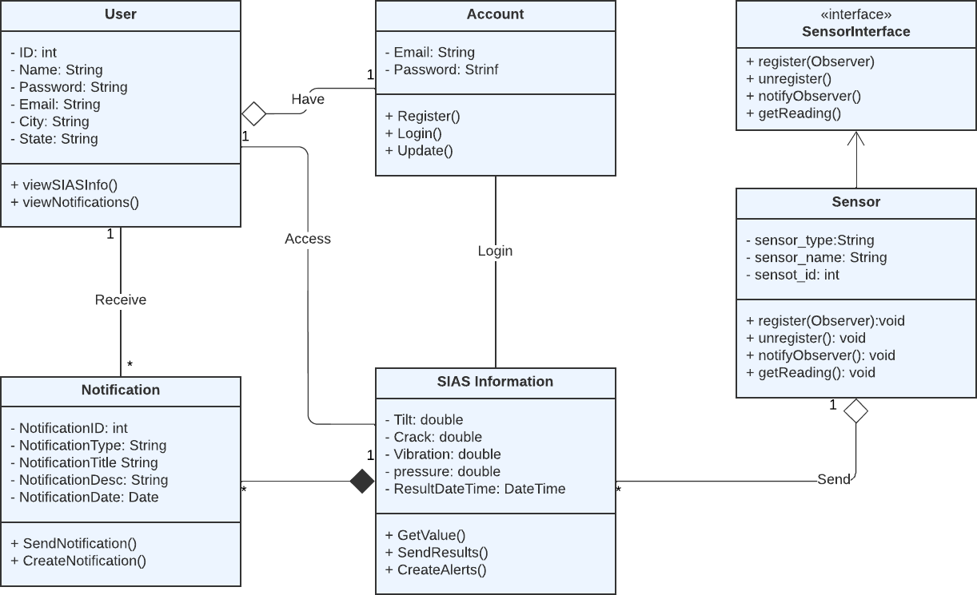
System Design – Class Diagram

Slide 10
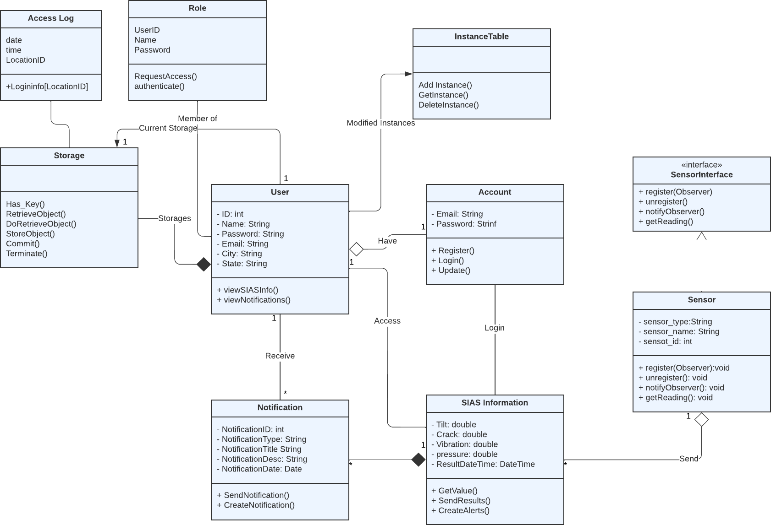
System Design - Object Design

Slide 11
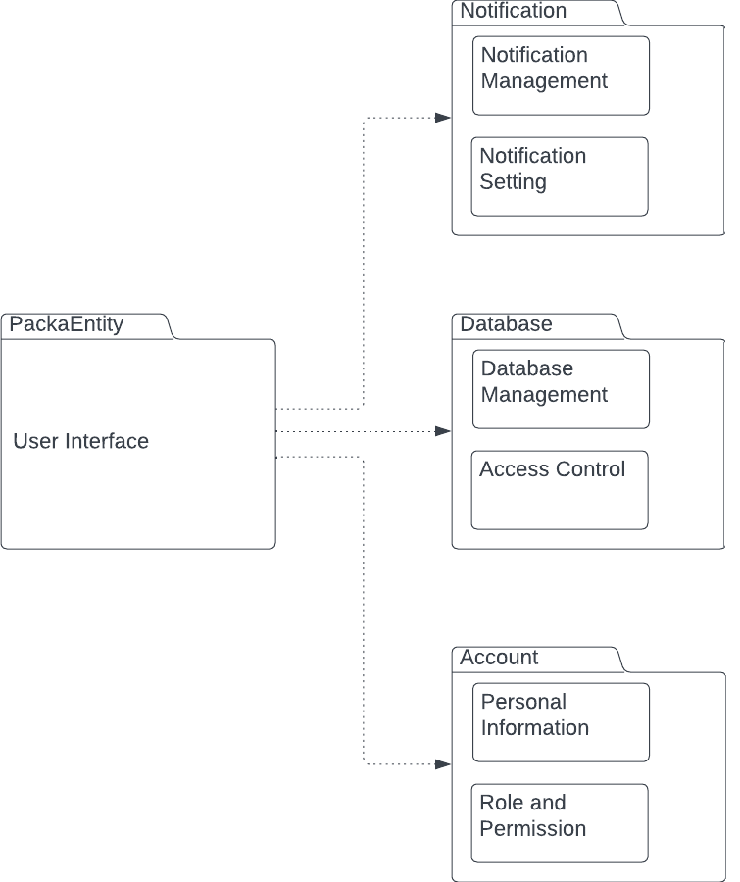
System Design - Packages

Slide 12
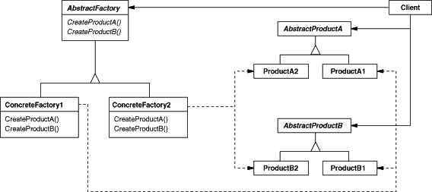
System Design – Design Pattern
All Sensors data need not be exposed to all reactors
Abstract Factories for sensors and reactors need to be designed
These can be linked via another class that models the communication protocol
A safe architecture for this common circumstance may be implemented
Concrete sensor and reactor models are super classed by the classes Abstract Sensor and Abstract Reactor

Slide 13
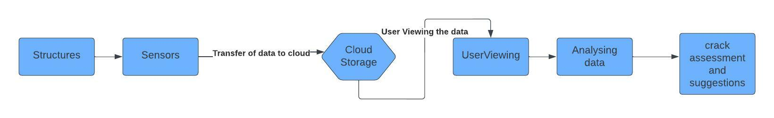
SIAS System
Multiple sensors connected to a cloud platform to transmit data to a local station

Slide 14
THANK YOU!

